Slide 1
State
Intent | Allow an object to alter its behavior when its internal state changes. The object will appear to change its class.
Problem | A monolithic object's behavior is a function of its state, and it must change its behavior at run-time depending on that state.

Slide 2
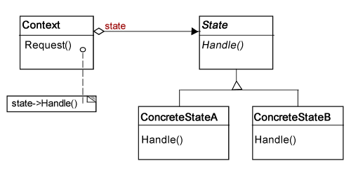
Solution

Slide 3
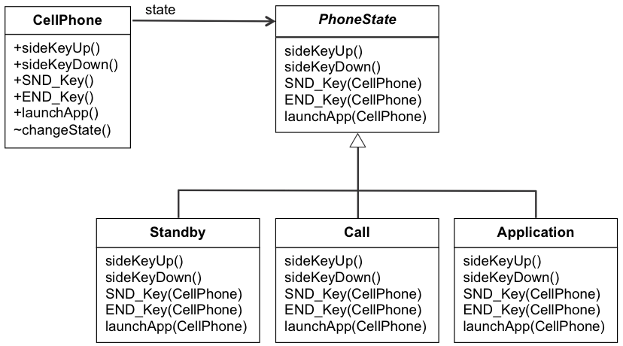
Example

Slide 4
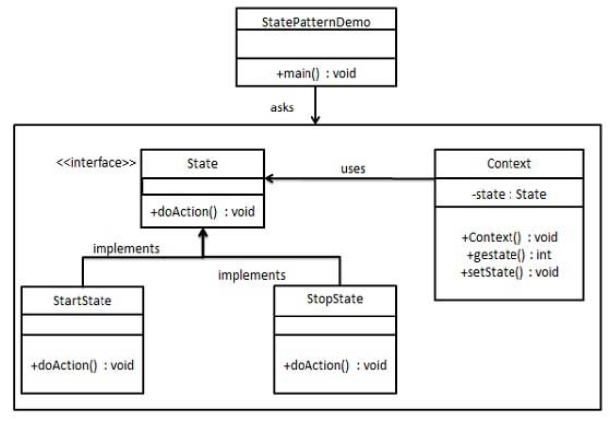


Slide 5
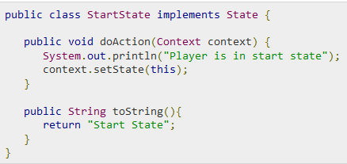
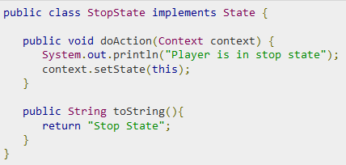

Slide 6
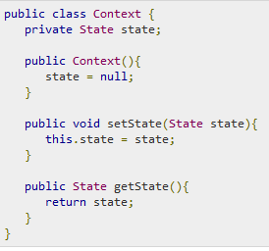
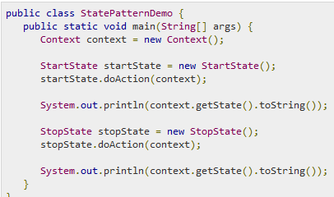

Slide 7
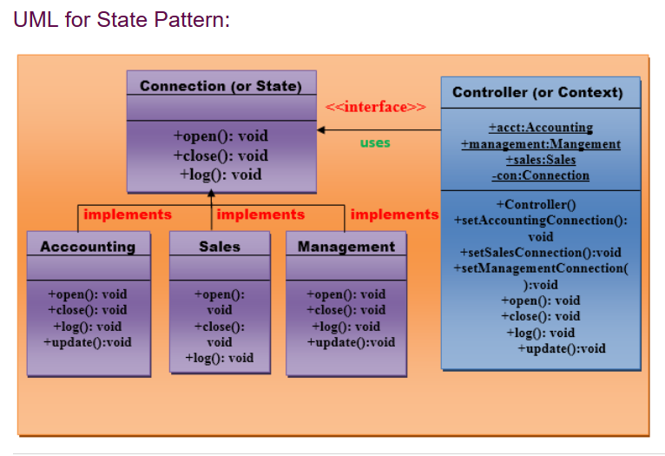

Slide 8
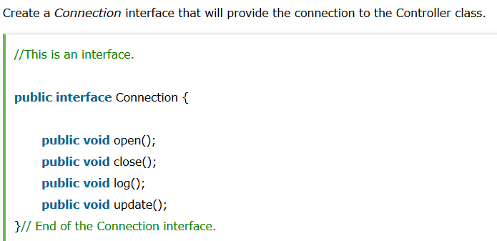
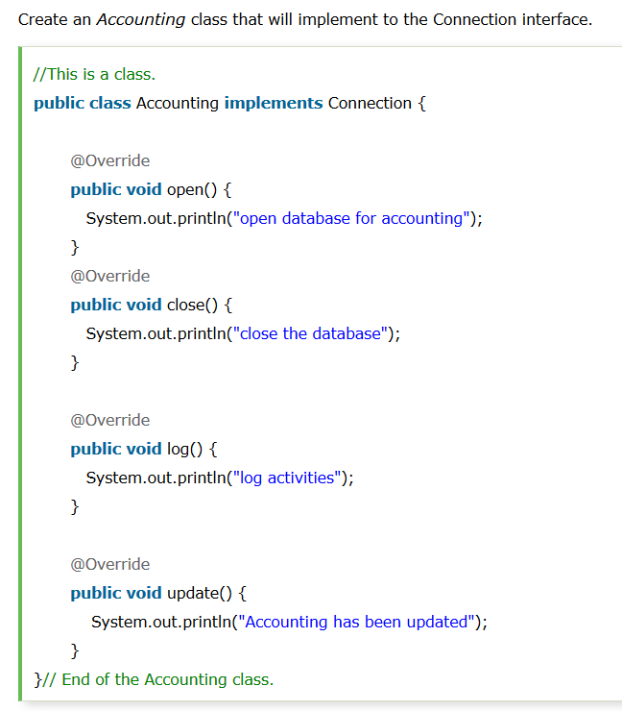

Slide 9
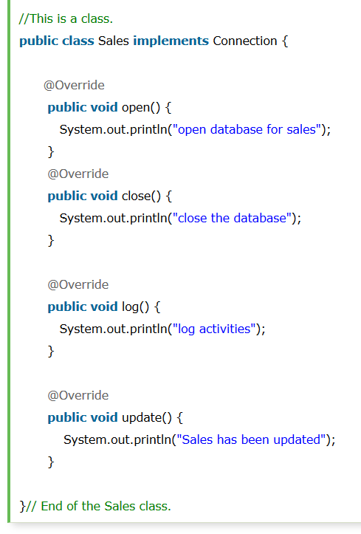
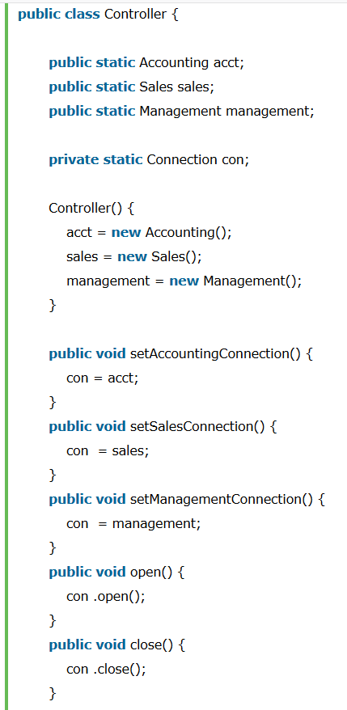

Slide 10
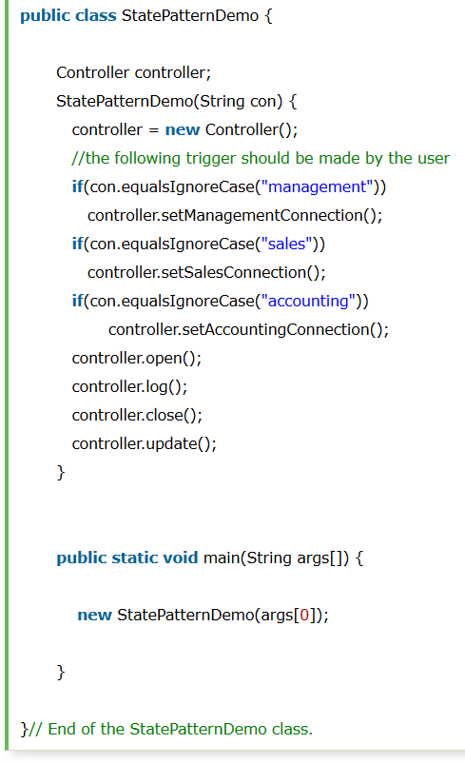

Slide 11
Consequences
Localizes the state specific behavior
Makes state transitions explicit

Slide 12
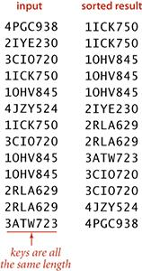
Motivation: Strategy
Quick sort
Merge sort
Insertion sort
Bubble sort
Radix sort
Heap sort
Bucket sort
..

Slide 13
Strategy
Intent | Define a family of algorithms, encapsulate each one, and make them interchangeable. Strategy lets the algorithm vary independently from the clients that use it.
Problem | Capture the abstraction in an interface, bury implementation details in derived classes.

Slide 14
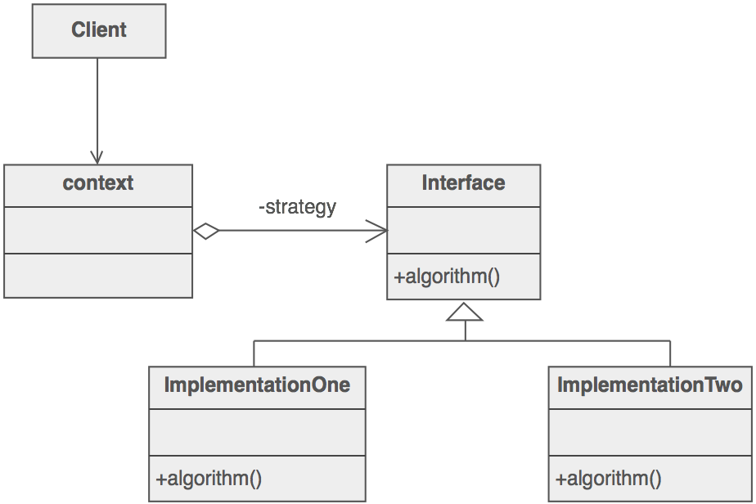
Solution

Slide 15
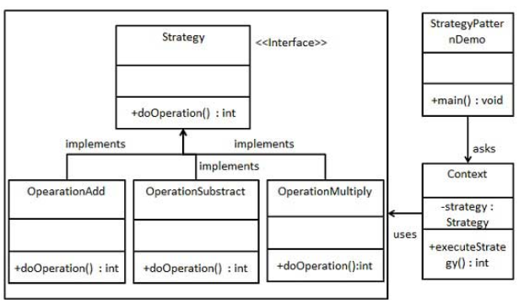


Slide 16
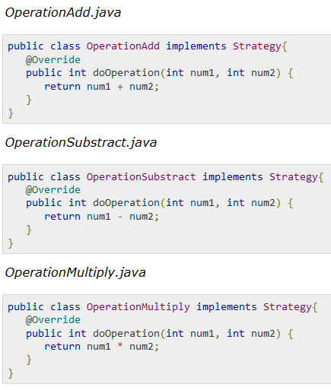

Slide 17
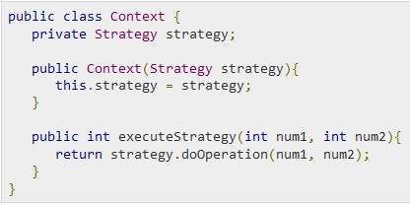
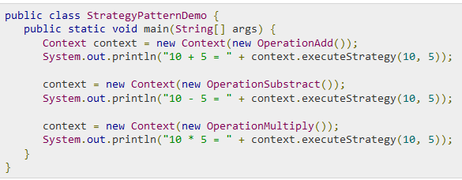

Slide 18
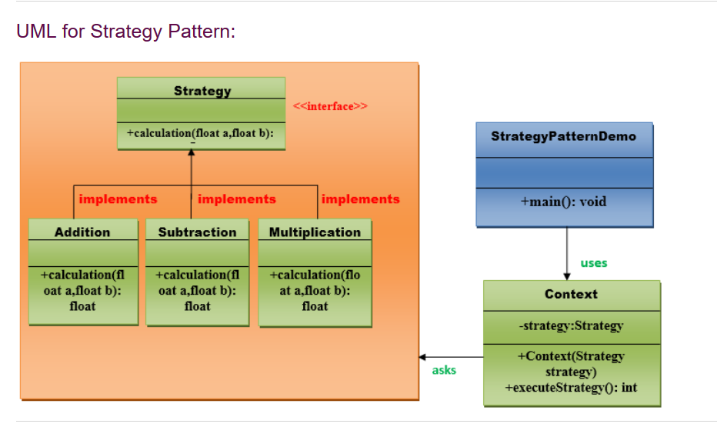

Slide 19
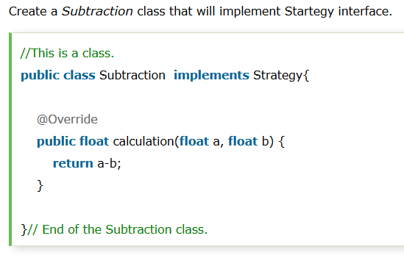
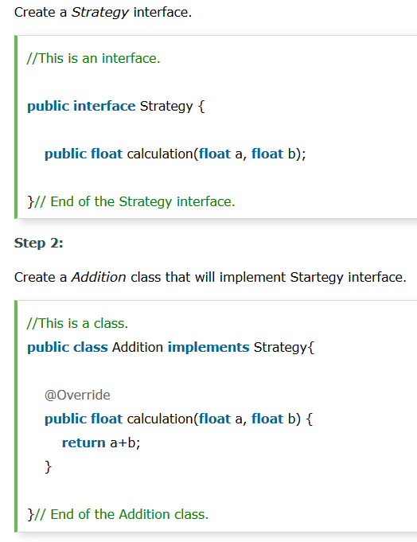
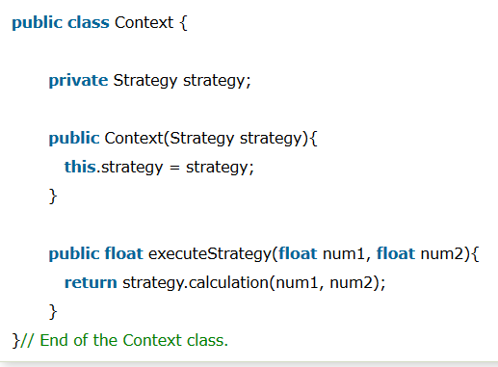

Slide 20
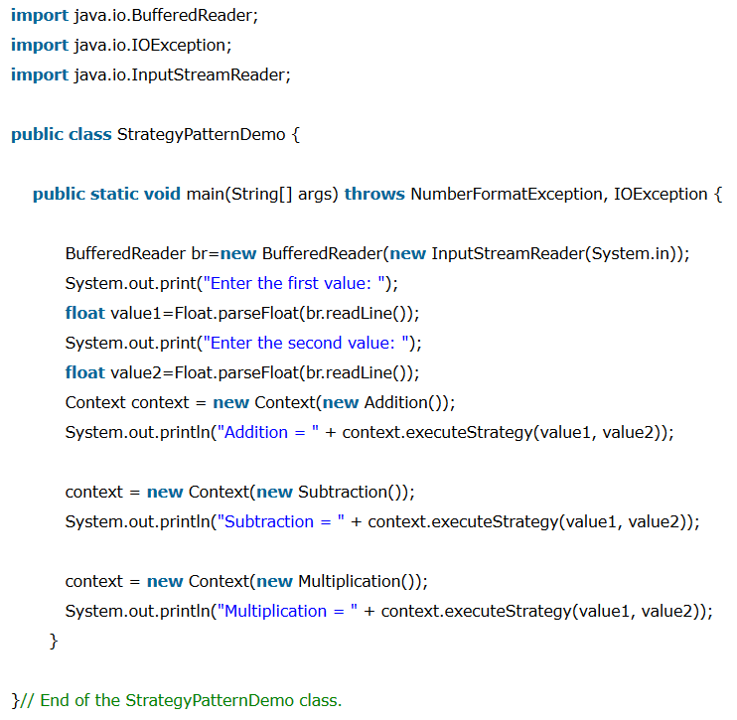

Slide 21
Consequences
Families of related algorithms
Eliminate conditional statements
Client must be aware of different strategies

Slide 22
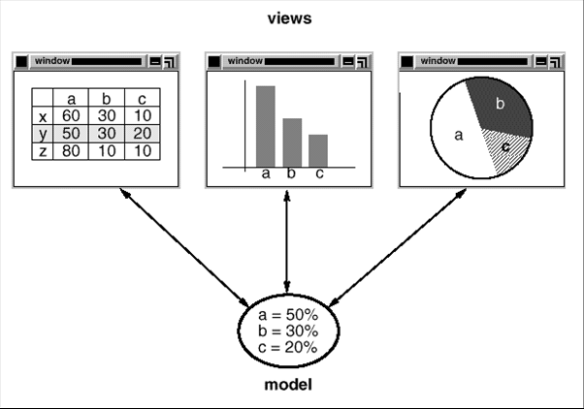
Motivation: Observer

Slide 23
Observer
Intent | Define a one-to-many dependency between objects so that when one object changes state, all its dependents are notified and updated automatically.
Problem | Encapsulate the core (or common or engine) components in a Subject abstraction, and the variable (or optional or user interface) components in an Observer hierarchy.

Slide 24
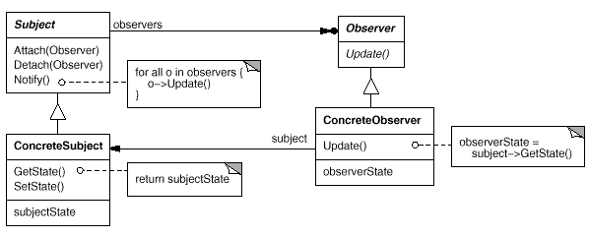
Solution

Slide 25
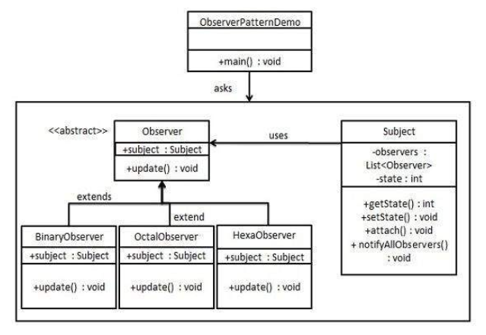

Slide 26
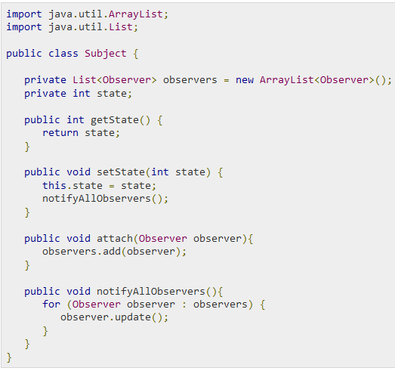

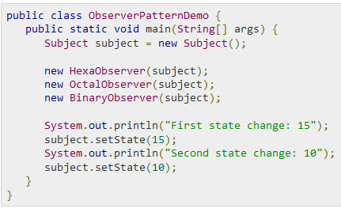
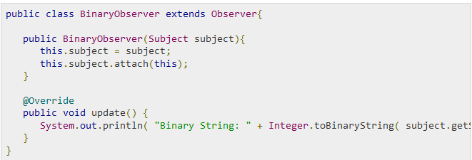

Slide 27
Consequences
Decoupling subject and observer
Support broadcast communication

Slide 28
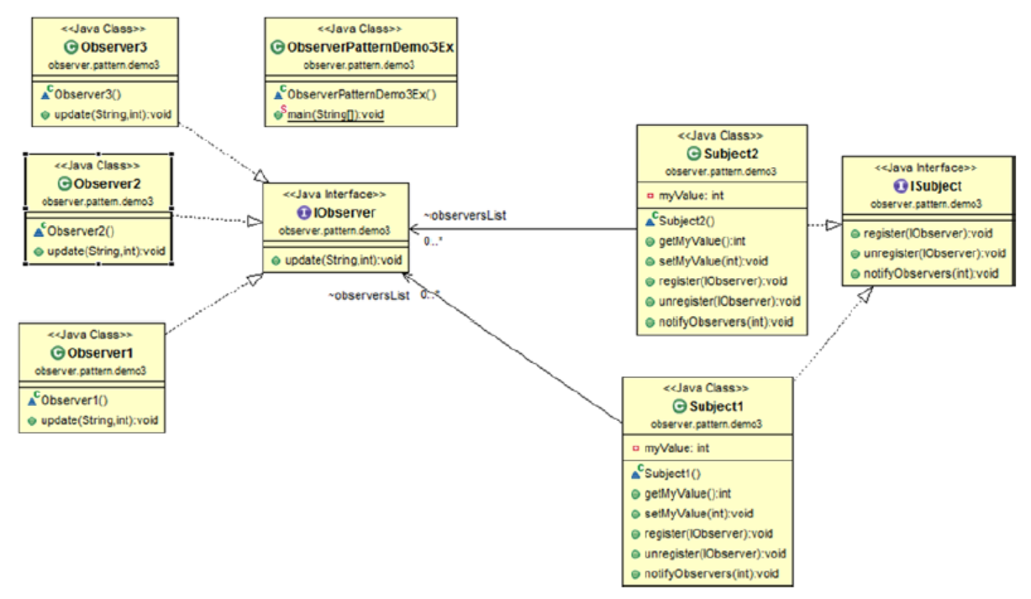
Many observers, many subjects

Slide 29
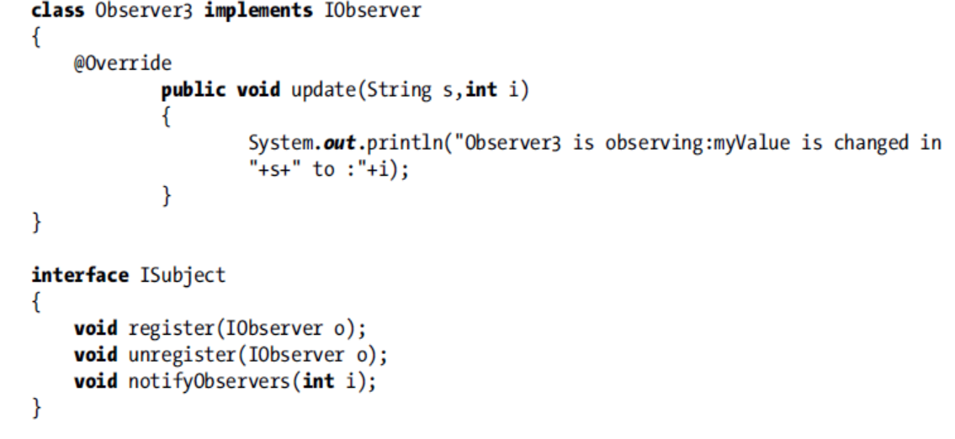

Slide 30
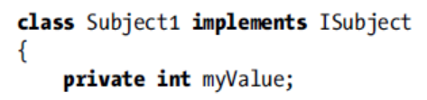
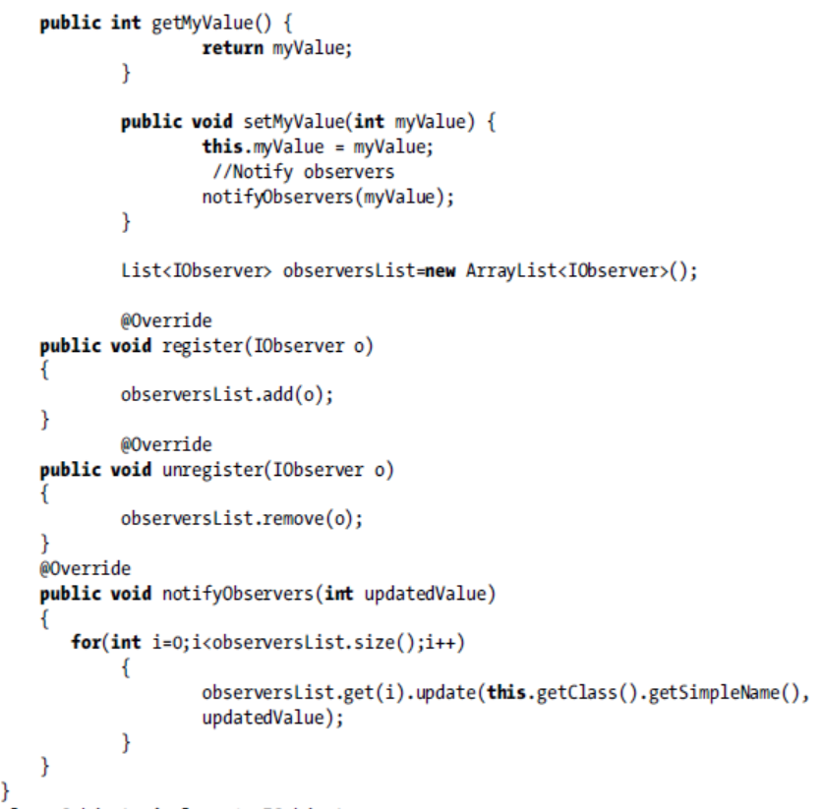

Slide 31
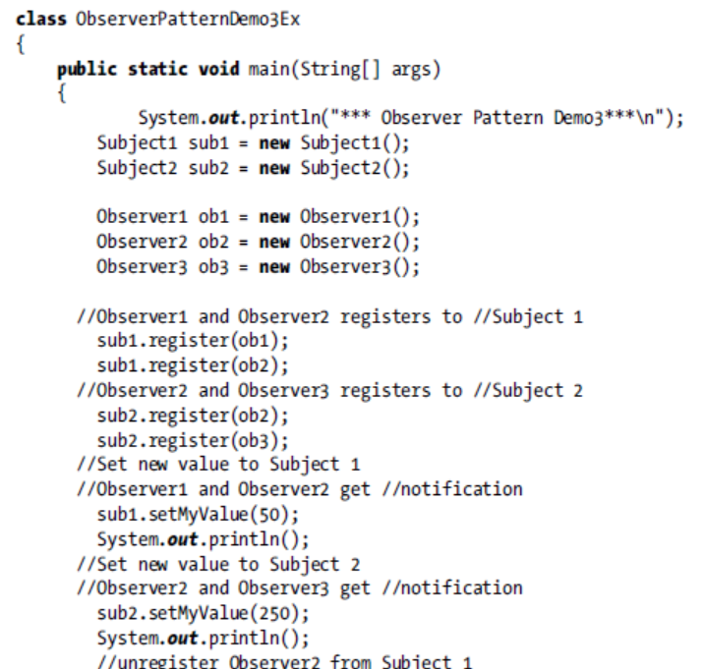

Slide 32
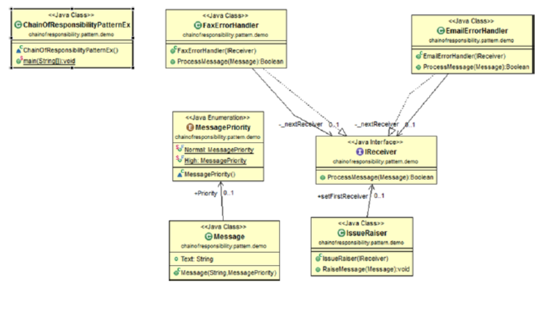
Chain of Responsibility

Slide 33
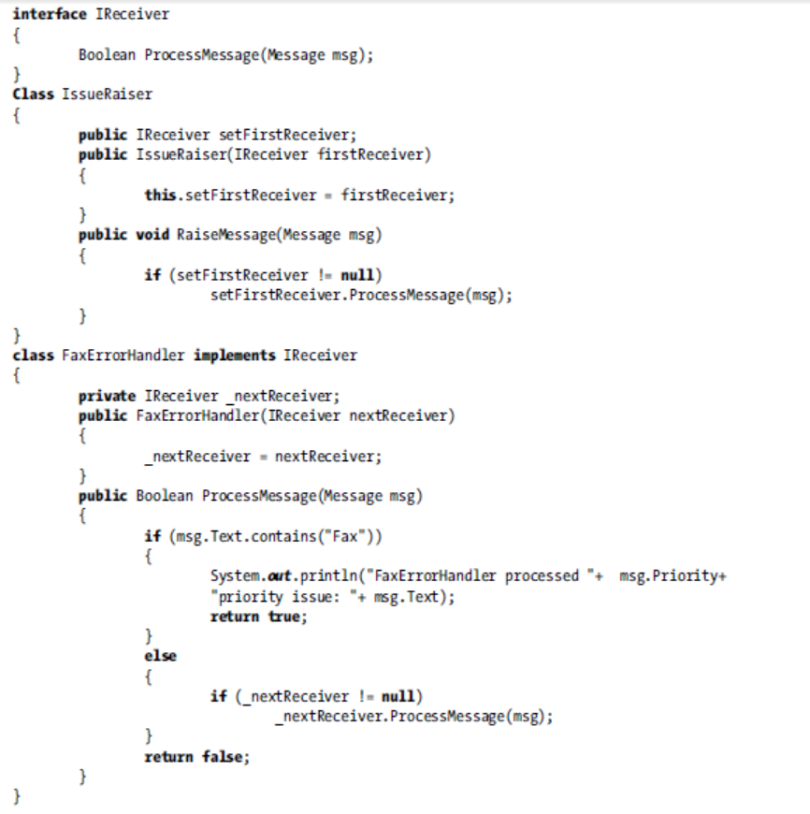

Slide 34
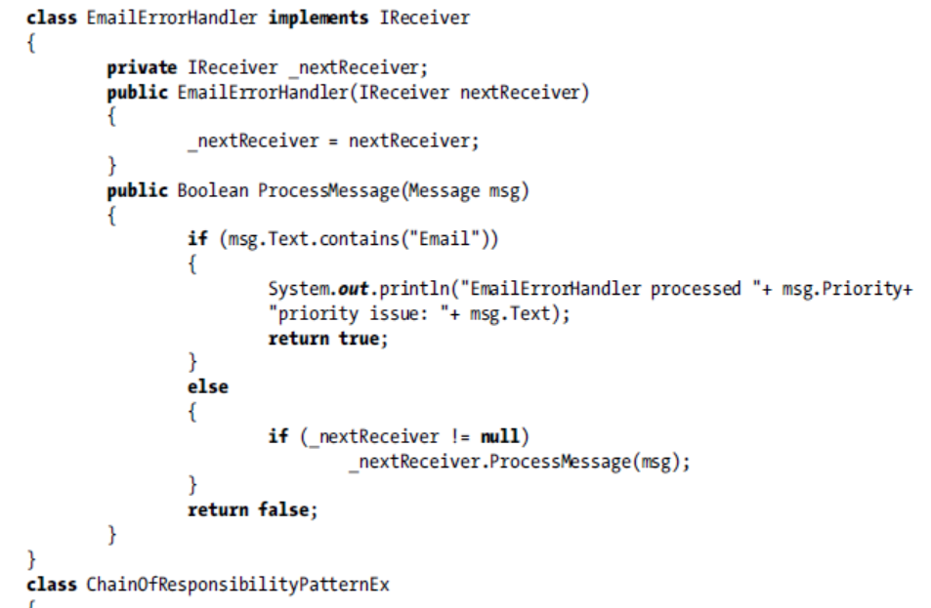

Slide 35
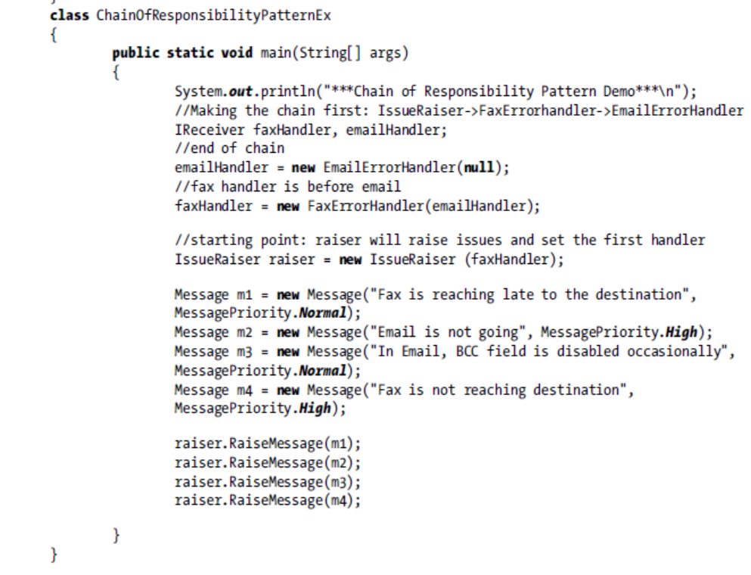

Slide 36
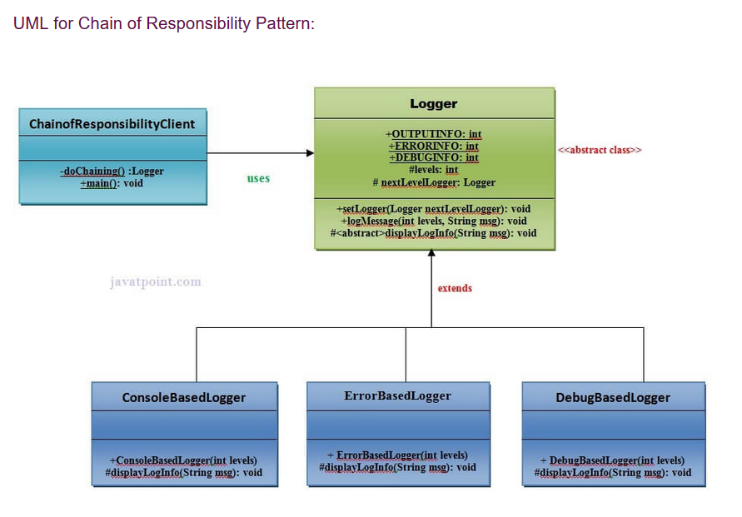

Slide 37
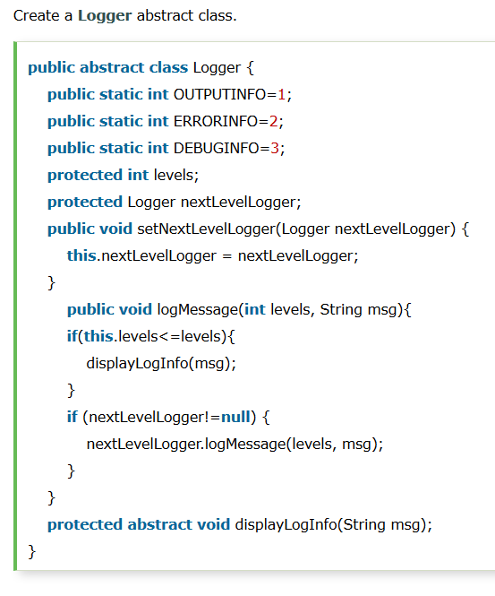

Slide 38
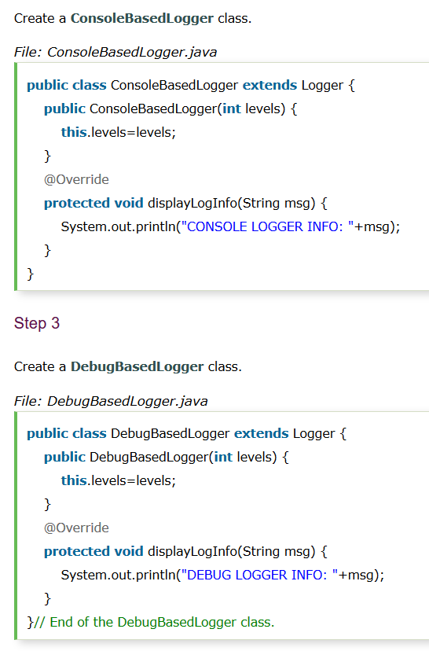

Slide 39
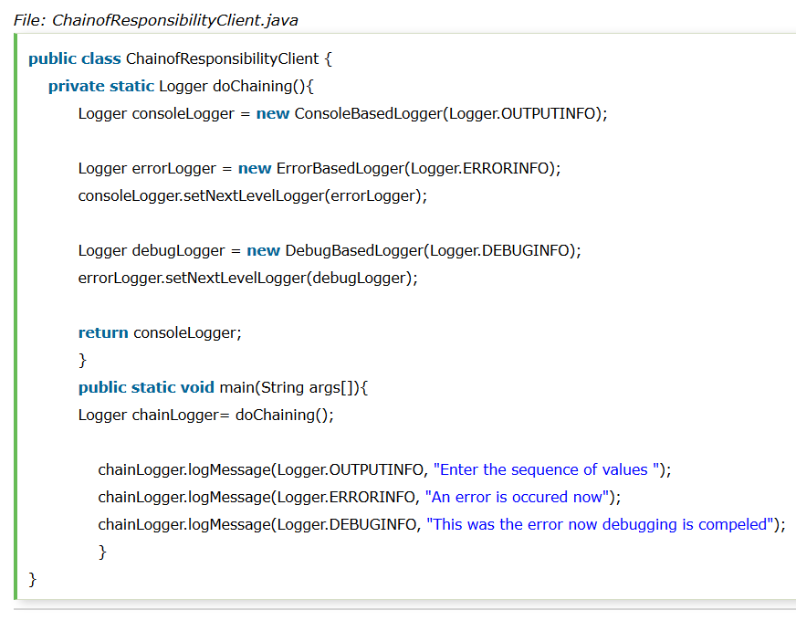

Slide 40
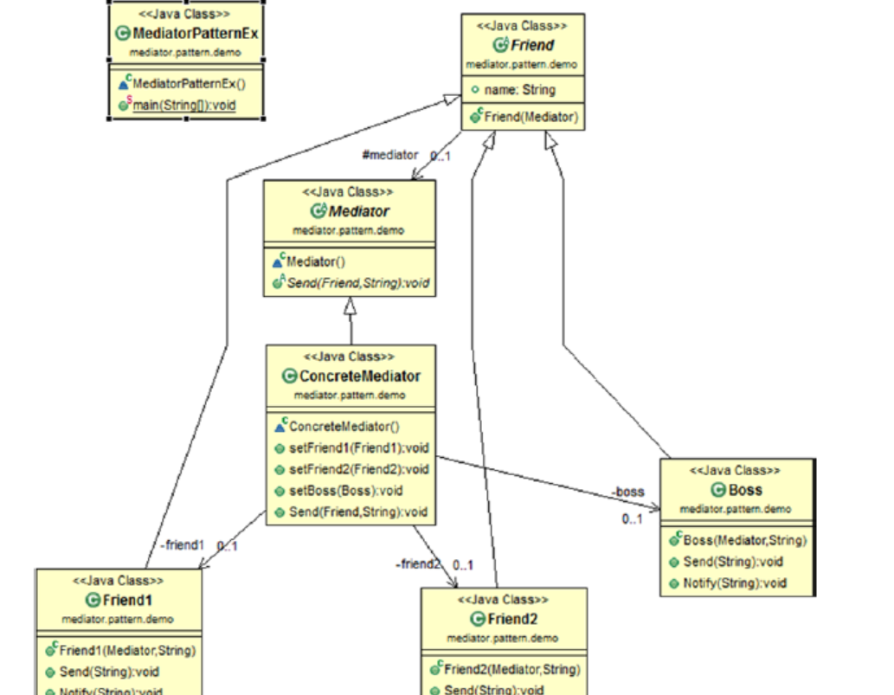
Mediator

Slide 41
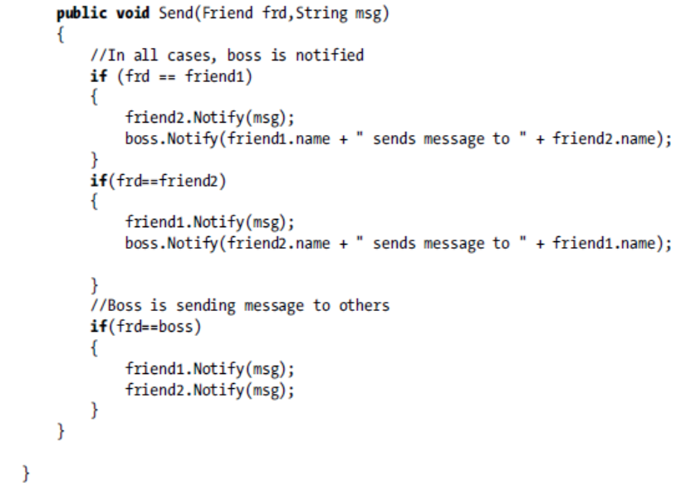

Slide 42
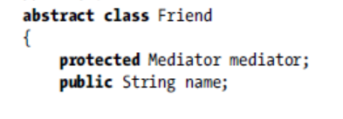
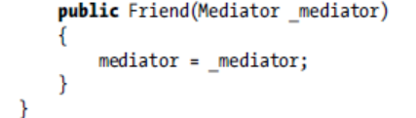
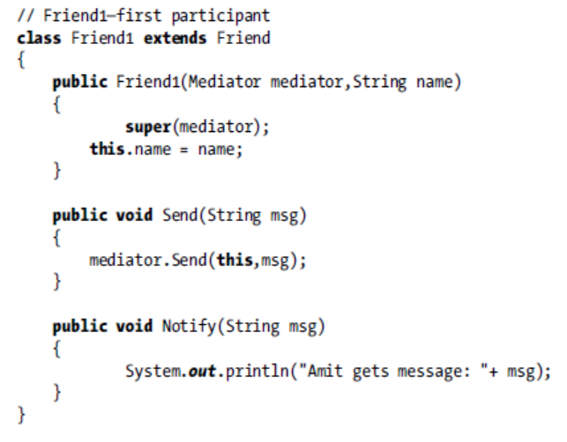

Slide 43
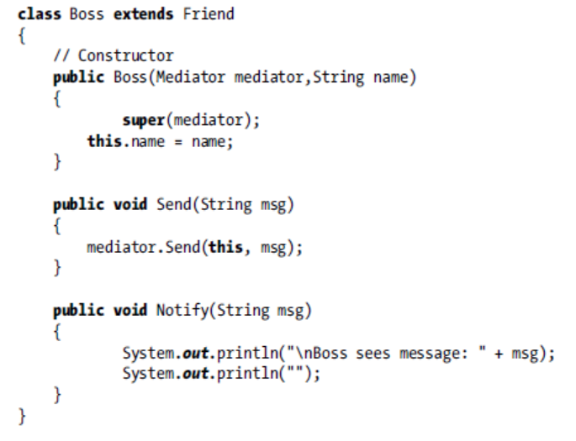

Slide 44
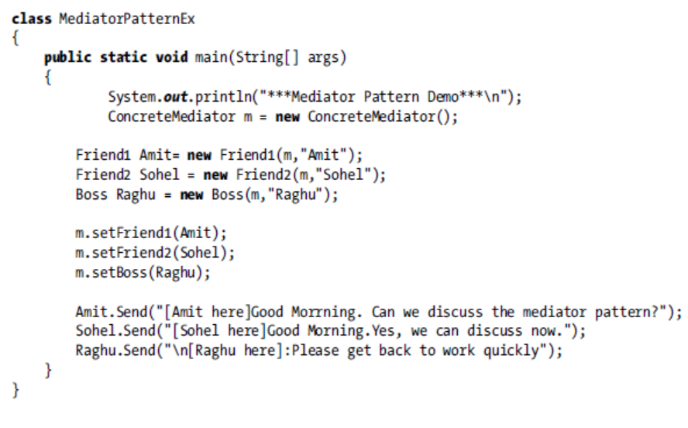

Slide 45


Slide 46


Slide 47



Slide 48



